Slide 1

V450: Project Management & Implementation
Class 7
Scope of Work I
Big 5 Questions
“How to manage a project: Limit it in scope. Make it simple. Get success. Then iterate." - Auren Hoffman

Slide 2
15 minutes too short, even with team break-outs.

Slide 3
Warm-Up
What do you want to be great at? What can you do today so you’re a little better tomorrow?
What was your first job? What was your best or worst job?

Slide 4

Max Bowne
Legislative Assistant to State Senators Jim Tomes and Dan Dernulc

Slide 5
Today’s Objectives
Understand that planning begins immediately upon getting the assignment, with 5 Big Questions to ask yourself.
Learn to answer these questions with the help of a trusted advisor.
Realize these questions are best answered early – answers become more costly down the line.

Slide 6


Slide 7
Pick a project.
Individual Skills Inventory due Sunday @ midnight
My User’s Manual.
Phase 1: Initiating
Phase 2: Planning.
Phase 3: Executing.
Phase 4: Monitoring.
Phase 5 Closing.
Self & Peer Evaluation.

Slide 8
Government: The Department of Motor Vehicles (DMV) has a severely outdated system for vehicle registration. The project manager needs to initiate a project to replace the current paper-based system with a new digital one.
Not-for-profit: A local NPO, "Food for All," wants to build a new community kitchen to increase its capacity to feed the homeless. The project manager needs to initiate this project. Students must write a project charter that includes the project's goals, objectives, and a high-level budget.
Environmental: A new environmental group wants to initiate a project to clean up a local polluted river, working with local, state and federal governments. The project manager needs to create a project charter outlining the project's purpose, high-level deliverables and key stakeholders.

Slide 9
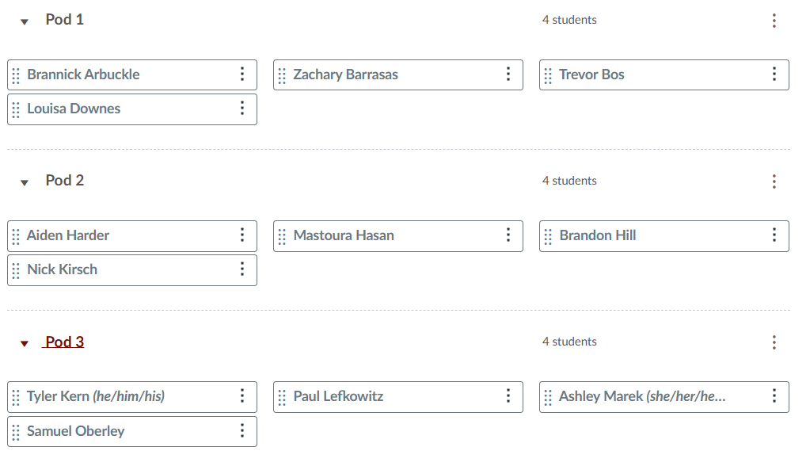

Slide 10
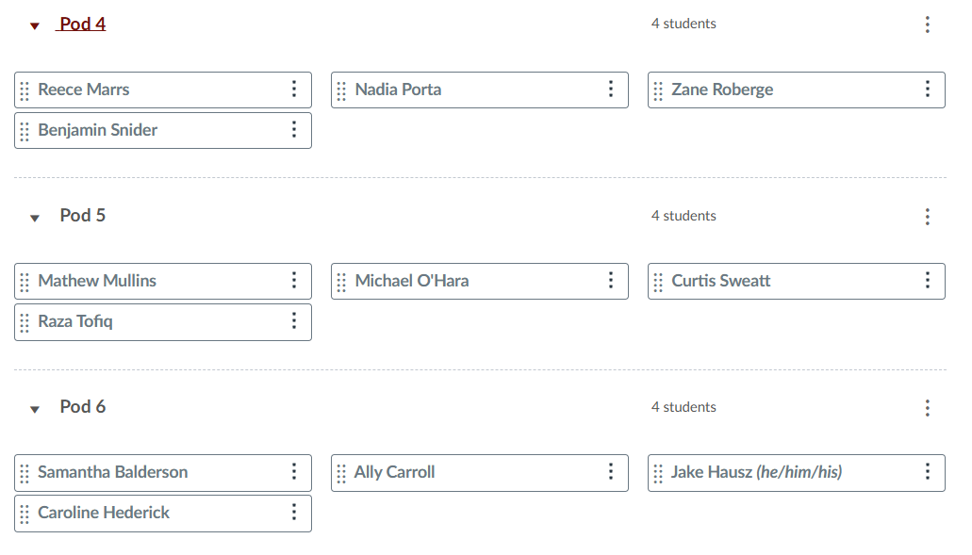

Slide 11
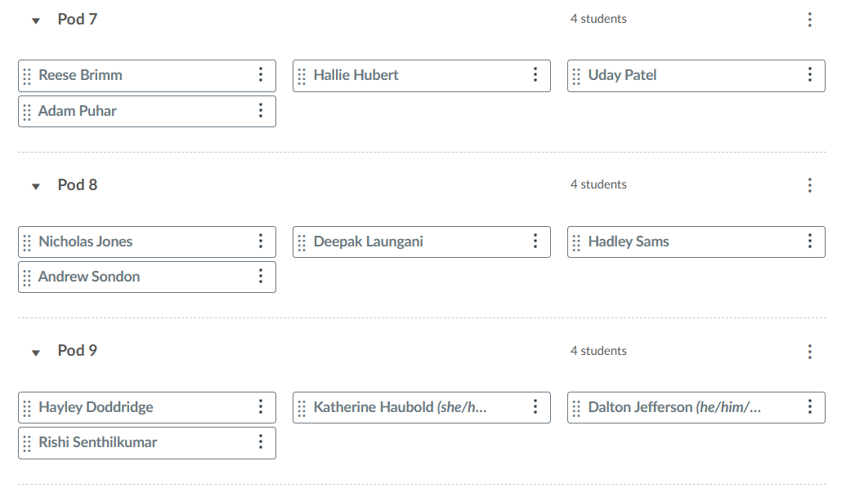

Slide 12
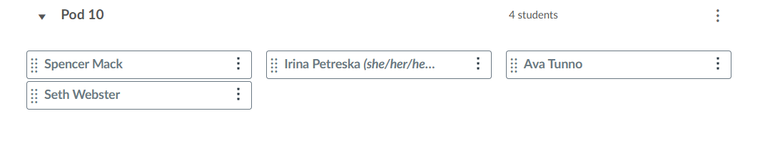

Slide 13

My pod!!
MyMy Pod!!

Slide 14
Meet Your Pod Your name, major and a food you will never eat again. Are you an introvert or an extrovert? What wrong assumptions do people make about you? Why you picked your topic. Exchange emails and preferred meeting times

Slide 15

Which of the 5 phases is considered the most critical and time-consuming?
Planning
About 90% of the PM’s work is related to communication with stakeholders. Why so much?

Slide 16
ꚙ The ‘Quick Start’ ꚙ
Today’s
PM Problem

Slide 17
Sarah, is a new project manager at "Innovate Solutions.” Her first project is to create a new app called "Math Adventures" for middle school students.
The project sponsor hands her a one-page project charter, emphasizing the 6-month deadline.
Eager to show she can get things done, Sarah jumps right in creating her team, designing the scope, etc.
Three months later, the head of IT points out that the proposed peer-to-peer payment feature is not compatible with the credit union's legacy systems and would require a massive, unbudgeted upgrade. The head of customer service explains that the sleek design is confusing for the credit union's older, less tech-savvy customer base, who were the primary target audience.

Slide 18

Name 3 critical project management questions should Sarah have asked at the beginning.

Slide 19

Big 5 Pre-Questions

Slide 20
You’ve just been given a big project.
Start by pre-planning for the plan.
Planners have the illusion that the sooner they imagine some goals and get those goals on paper, the sooner they’ll achieve those goals, as well. So that’s where they start – fantasizing about goals.
Too dangerous – it’s like going on a trip without a map and then complaining that you didn’t get where you wanted to go. Or who’s driving.
Notes:
Start by realizing you are officially planning, and official planning doesn’t start with the project itself. It starts with the PM’s environment.

Slide 21

What questions would pop into your mind after being given a big project?

Slide 22
Big 5 Pre-Questions/Pre-Planning
↓
Requirements
↓
Expectations
↓
Goals & Objectives
↓
Deliverables
↓
Scope of Work Action Plan
↓
Work Breakdown Structure
The Big Plan
Notes:
Here is the flow of works when preparing the scope for a project.

Slide 23

Big 5 Pre-Questions
What’s our history of project planning?
What’s Your Role?
How Much Juice Do You Have?
Who is Your Patron?
What Kind of Plan is it?
Q1
Q2
Q3
Q4
Q5

Slide 24
Why is it important to study previous plans? Will reading previous plans be enough to prepare you?

Slide 25

You can ‘go to school’ on studying previous reports, particularly details about approaches, gathering input and making recommendations.
Prepare some questions and then meet with the previous PM, in a non-threatening manner.

Slide 26

Q1: What’s our history of project planning?
Are you, the PM, building upon an organizational history of project successes or failures? What the morale and confidence level? Are there trust issues?
Do we have enough resources to allocate? Are their decision-making skills?
Beware: Organizational or staff development may be needed first.
Notes:
The first big question is about your organization’s history of successfully completing projects. Are they good at it? Ask: does everyone handle projects the same way? why was this project a success? What went wrong with that one? What can you learn from past projects?

Slide 27
For a team that hasn’t worked together, why is the boss’ suggestion that team members “work out leadership roles among themselves” be problematic?

Slide 28
Bosses may be reluctant to “show favorites” by picking a team manager, but when no leader is assigned, it almost certainly leads to confusion, lack of direction and delays in launching.

Slide 29

Q2: What’s Your Role?
While you might think everyone agrees who’s in charge, in fact leadership may not be clear, especially with new or short-term projects. Clarify your role and the roles of others.
Beware of orders to “just work it out among yourselves.” Get decisions.
Notes:
Next, make sure that you are the official Project Manager, or that the team does have an assigned leader.

Slide 30
Q2: What’s Your Role?
What’s the context of your role:
In-house staff
Consultant staff
Main contractor
Sub contractor
Support
Stakeholder
Agency representative
Usual Suspect
Local do-gooder
Notes:
A second part to this question is establishing your formal role in the process. For example, are you part of a consulting team.

Slide 31

Why can it be a problem when a boss has a steady stream of suggestions to the PM after the project starts?

Slide 32
Why can it be a problem when a boss has a steady stream of suggestions to the PM after the project starts?

Slide 33
As we’ll see, the time for all those suggestions is before the work begins – when putting together the scope of work - and not when the project is humming along.
Otherwise, the suggestions fall into the dangerous category of ‘micro-managing.’

Slide 34
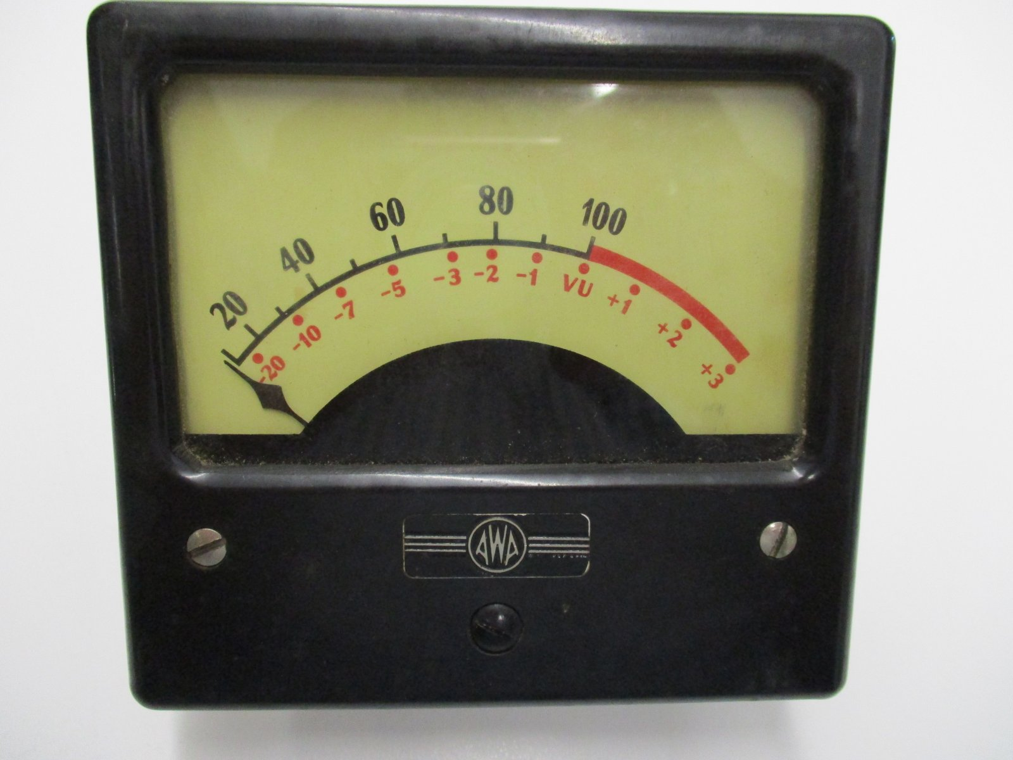
Q3: How Much Juice Do You Have?
Although you’re working for a client or customer, someone must be in charge of calling the overall and the day-to-day shots for the project. That role belongs to the PM.
Beware of micro-management.
Notes:
Read.

Slide 35
Q3: How Much Juice Do You Have?
Ask if you’re in charge of the:
Steering committee
Planning process
Budget
Timeline
Final recommendations
Political fall-out
If you’re not in charge of any of these things, you’re not the PM.
Notes:
Read.

Slide 36
Why do you need a local supporter, particularly if you’re working in a new community or department?

Slide 37

Q4: Who is Your Patron?
A patron is a special guardian, protector or supporter of the project in general and the PM specifically.
They could – and should – be the client, of course, but they might also be someone outside the project who can still provide special insights or influences.
Notes:
Every PM should have a Patron, a higher-up with some power to help them.

Slide 38
Q4: Who is Your Patron?
A patron offers the PM things they may not be able to secure by themselves:
Lay of the Land
Inside knowledge
Early Warning System
Protection Under Fire
Desired Outcomes
Must-Have Approval
Notes:
Read.

Slide 39
Q4: Who is Your Patron?
Patrons are vital if the PM doesn’t actually work in the organization or community where the project is taking place. For instance, if they are a consultant.
Notes:
Read.

Slide 40
Q4: Who is Your Patron?
If a patron doesn’t present themselves or isn’t immediately apparent, search for someone who can advise you and then develop a relationship.
Notes:
Read.

Slide 41

Q5: What Kind of Plan is it?
Once again, people will have different ideas about what type of plan is needed:
‘Down-and-dirty’
Just the Quick Fix, please
One-Plan-Solves All
Only what’s needed to make a decision
Notes:
Finally, everyone should agree on the size of the plan, it’s general limits and purpose. For example, it is a long-term plan or more of a short-term, strategic one?

Slide 42
Q5: What Kind of Plan is it?
One way to separate:
Long-range planning involves setting goals and establishing a framework for achieving those goals over an extended period.
Strategic planning focuses on the formulation and execution of strategies to achieve its long-term objectives, usually with a detailed action plan and budget.
Notes:
Learn the difference between these two types of plans.

Slide 43
Q5: What Kind of Plan is it?
Questions to explore:
What’s the best planning process for this type of plan?
What should the table of contents look like?
Is there an old plan I can update?
If there is no previous plan - R&D.
Notes:
Read.

Slide 44
Check previous, successful projects.
Meet with teammates to discuss.
Seek expert judgement.
R&D.
What is R&D?
Notes:
Take these steps when deciding what type of project you’ll have.

Slide 45
Rob & Duplicate
Notes:
It means Rob & Duplicate.

Slide 46
Don’t spend time wondering what the ideal comp plan or public survey or steering committee questionnaire or executive summary might look like.
Climb up and stand upon the shoulders of giants.
I’ll look at a minimum of 6 examples from other communities, consultants or countries. Chances are I won’t like any one, but I can lift ideas from several.
You are not stealing fundamental research or copyrighted material. You are customizing approaches, formats, wording, etc.
Notes:
Read.

Slide 47
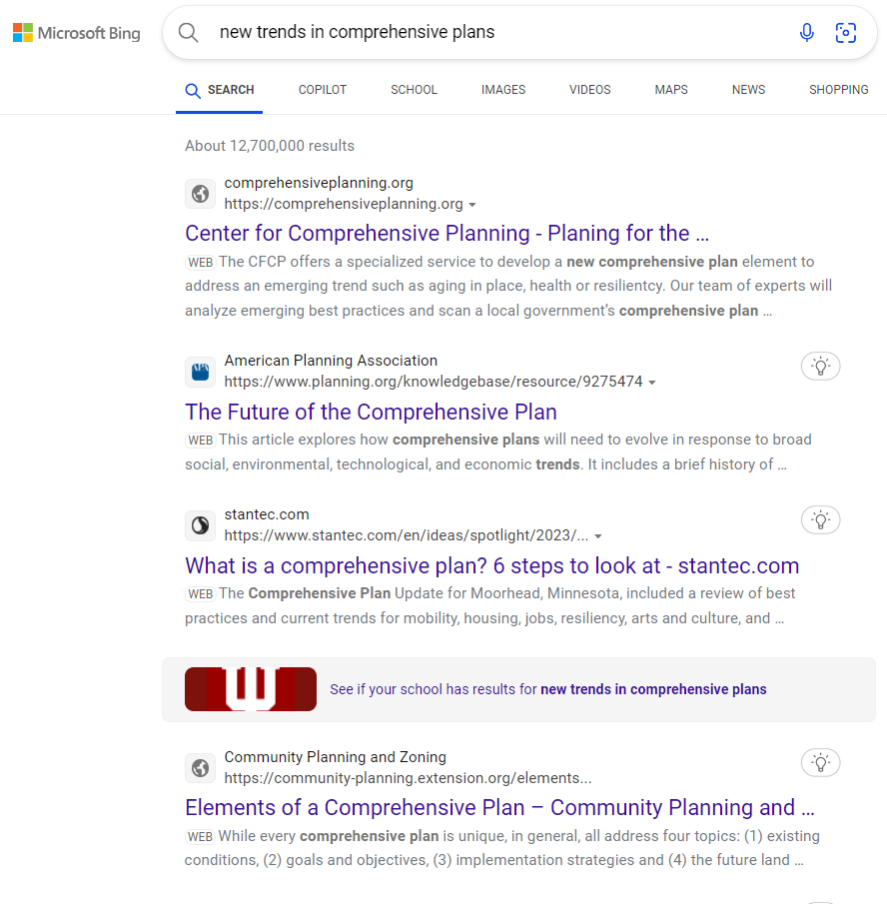
Notes:
I’ve done 20 comprehensive land use plans for cities, but every time I have a new one, I start with a search – something like new trends in comp plans.

Slide 48
Notes:
I look for interesting hits.

Slide 49
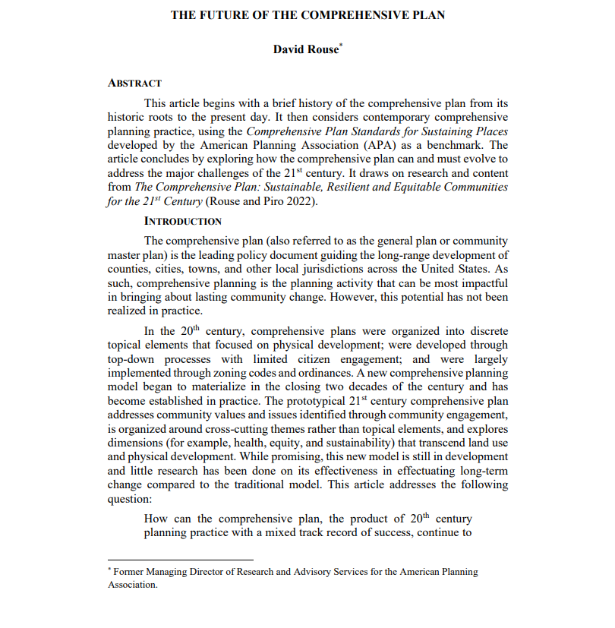
Notes:
Then follow up. I’m working to stay current because how plans are carried out are constantly evolving.

Slide 50
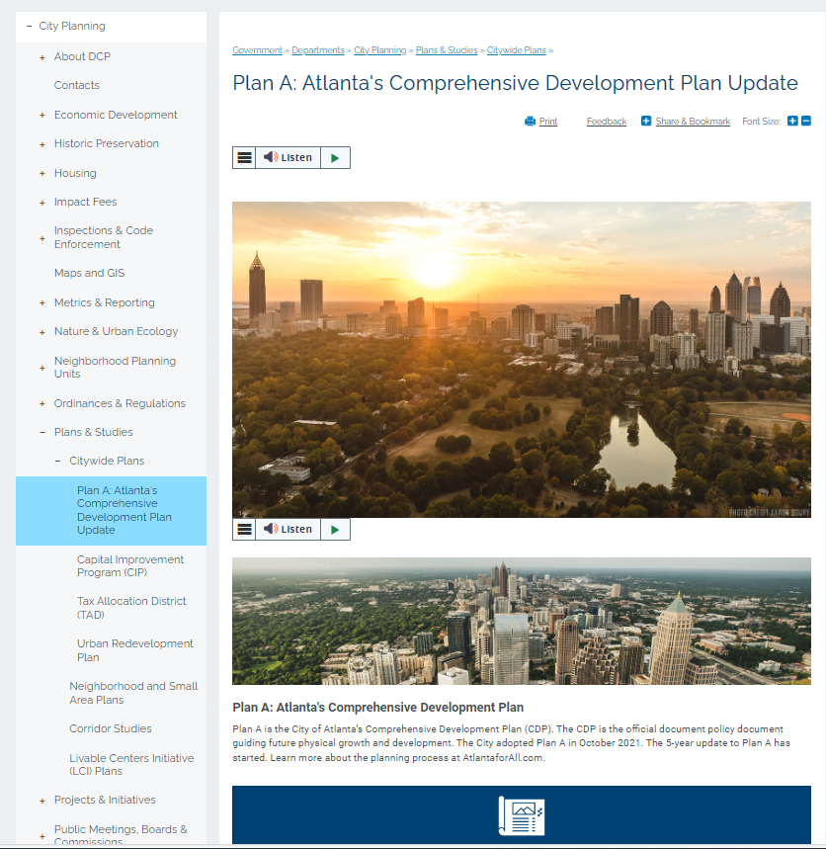
Notes:
For example, I checked Atlanta’s most recent plan.

Slide 51
Notes:
This looked interesting.

Slide 52
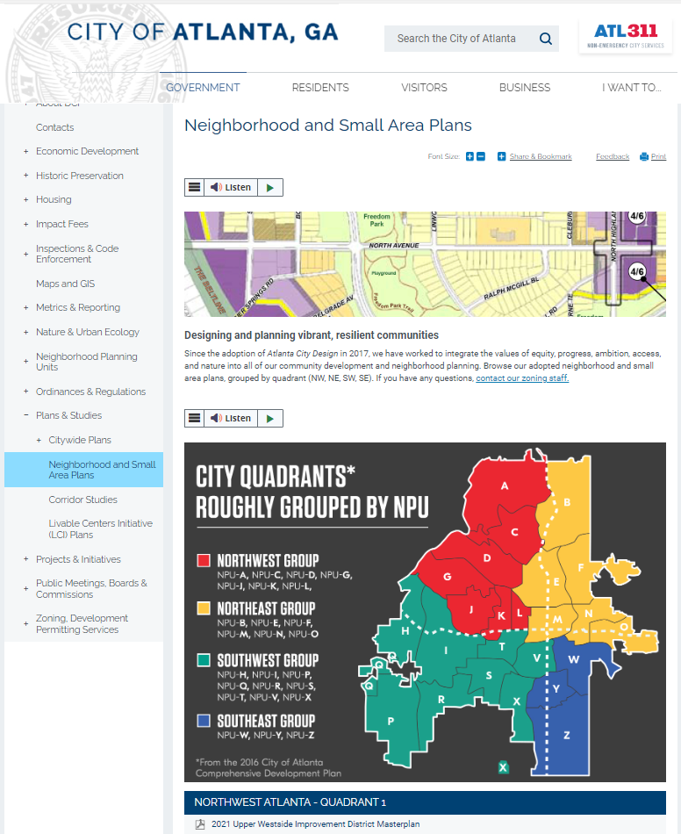
Notes:
And I ended up “stealing” their idea to create a color-coded map of neighborhoods. They, no doubt, stole the idea form some other cityt.

Slide 53

Confer with your pod:
What kind of R&D can you do for your project? Where would you look?

Slide 54
Confer with your 2 classmates:

Slide 55


Make sure you know the answers to the Big 5 Pre-Questions before formally start the scope of work.

Slide 56


Slide 57
Class 8 Check-In

